Slide 1
Gaussian Process Prior Variational Autoencoder Accepted in NeurIPs 2018
Kyeong Ryeol, Go
M.S. Candidate of OSI Lab

Slide 2
Contents
VAE [1]
Beta-VAE [2]
GPP-VAE [3]
[1] Kingma, Diederik P., and Max Welling. "Auto-encoding variational bayes." arXiv preprint arXiv:1312.6114 (2013).
[2] Higgins, Irina, et al. "beta-VAE: Learning Basic Visual Concepts with a Constrained Variational Framework." ICLR 2.5 (2017): 6.
[3] Casale, Francesco Paolo, et al. "Gaussian process prior variational autoencoders." Advances in Neural Information Processing Systems. 2018.

Slide 3
VAE Intro
Aim
Performing efficient approximate inference on latent variables that has intractable posterior
Contribution
Introduce a differentiable unbiased estimator of variational lower bound
- Stochastic Gradient Variational Bayes(SGVB) estimators
Introduce an algorithm to learn the associated parameters in mini-batch unit
- Auto-Encoding Variational Bayes(AEVB) algorithm

Slide 4
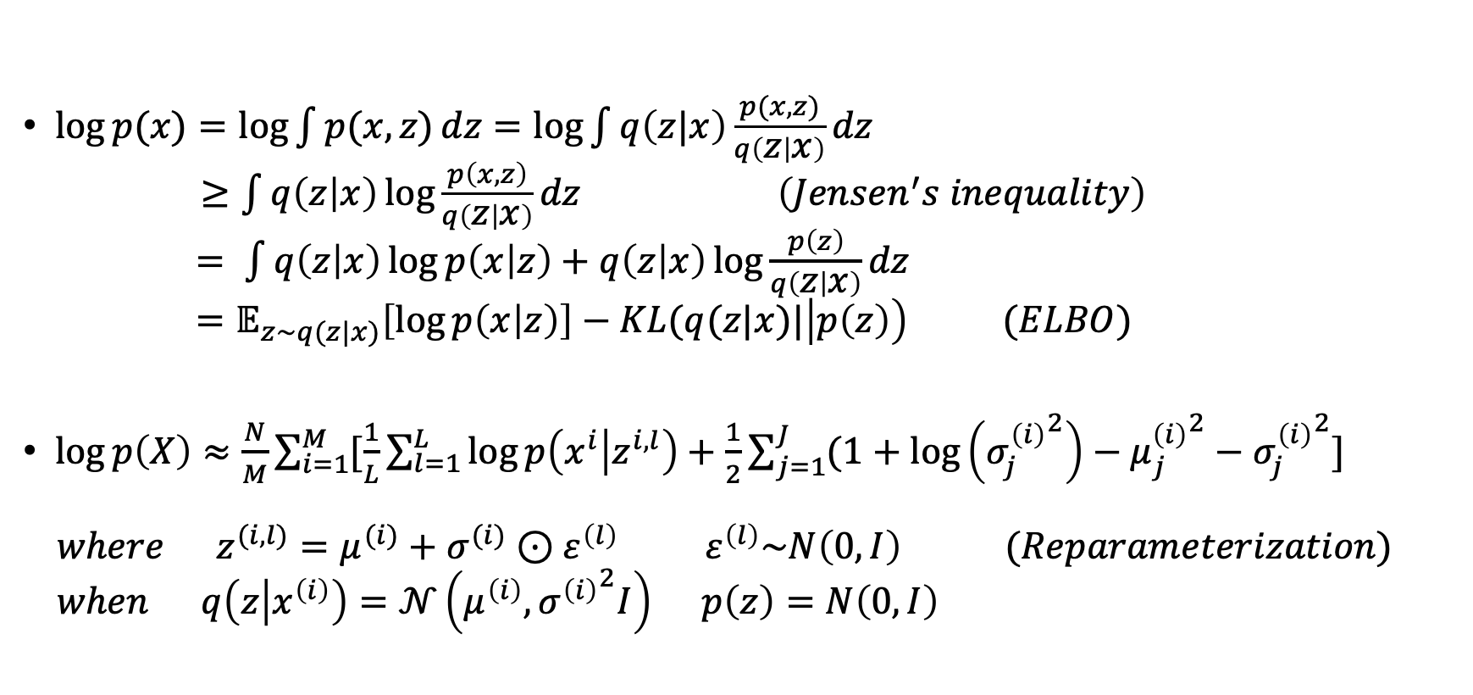
SGVB / AEVB
$\log{p(x)}=\log{\int{p(x,z)}dz}=\log{\int{q\left(z|x\right)\frac{p(x,z)}{q\left(z | x\right)}dz}}$ $≥\int{q\left(z | x\right)\log{\frac{p\left(x,z\right)}{q\left(z | x\right)}}dz} \left(Jensen^{′}s inequality\right)$ $= \int{q\left(z | x\right)\log{p\left(x | z\right)}+q\left(z | x\right)\log{\frac{p\left(z\right)}{q\left(z | x\right)}}}dz$ $=𝔼_{z\sim q(z|x)}\left[\log{p\left(x | z\right)}\right]−KL(q(z|x)|\left|p\left(z\right)\right) (ELBO)$
$\log{p\left(X\right)}≈\frac{N}{M}\sum_{i=1}^{M}{[\frac{1}{L}\sum_{l=1}^{L}{\log{p\left(x^{i} | z^{i, l}\right)}+\frac{1}{2}\sum_{j=1}^{J}{(1+\log\left({σ_{j}^{\left(i\right)}}^{2}\right)−{μ_{j}^{\left(i\right)}}^{2}−{σ_{j}^{\left(i\right)}}^{2}}]}}$ $where z^{(i,l)}=μ^{(i)}+σ^{(i)}⊙ε^{\left(l\right)} ε^{\left(l\right)}\sim N\left(0, I\right) (Reparameterization)$ $when q\left(z | x^{\left(i\right)}\right)=𝒩\left(μ^{\left(i\right)},{σ^{\left(i\right)}}^{2}I\right) p\left(z\right)=N\left(0, I\right)$
$$N :total data points, M \left(≈100\right):batch size, L \left(≈1\right):number of samples of z on each x^{i}, J:\dim{(z)}$$

Slide 5
Learning a disentangled representation
Where is it useful?
- supervised learning
- reinforcement learning
- transfer learning
- zero-shot learning
Problem : the definition of disentanglement is still open to debate
Bengio et al (2013)
“A representation where a change in one dimension corresponds to a change in one factor of variation, while being relatively invariant to changes in other factors”

Slide 6
Beta-VAE Intro
Aim
Learning a disentangled factor in a purely unsupervised manner augmenting VAE framework
Contribution
Introduce a constrained optimization problem
Devise a metric to quantify the degree of disentanglement

Slide 7
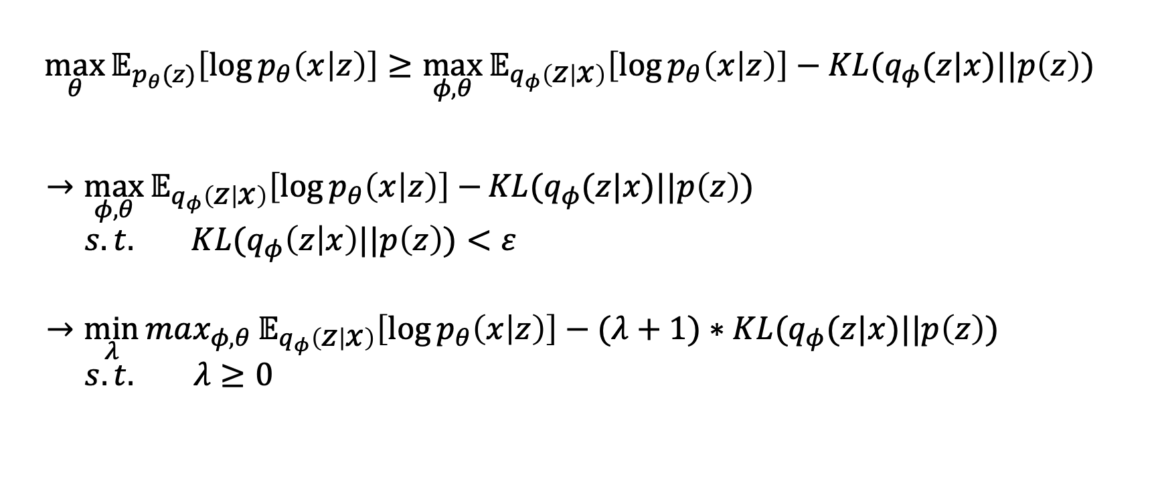
Formulation
$$\max_{θ}{𝔼_{p_{θ}(z)}\left[\log{p_{θ}\left(x | z\right)}\right]}≥\max_{φ,θ}{𝔼_{q_{φ}\left(z | x\right)}\left[\log{p_{θ}\left(x | z\right)}\right]−KL(q_{φ}(z|x)||p\left(z\right)) }$$
$→\max_{φ,θ}{𝔼_{q_{φ}\left(z | x\right)}\left[\log{p_{θ}\left(x | z\right)}\right]−}KL(q_{φ}(z|x)||p\left(z\right))$ $s.t. KL(q_{φ}\left(z | x\right)||p\left(z\right))<ε$
$→\min_{λ}{max_{φ,θ}{𝔼_{q_{φ}\left(z | x\right)}\left[\log{p_{θ}\left(x | z\right)}\right]−(λ+1)∗KL(q_{φ}(z|x)||p\left(z\right)) }}$ $s.t.$ $λ≥0$
Disentangled representations can be captured when the right balance is found
between data reconstruction and latent regularization

Slide 8
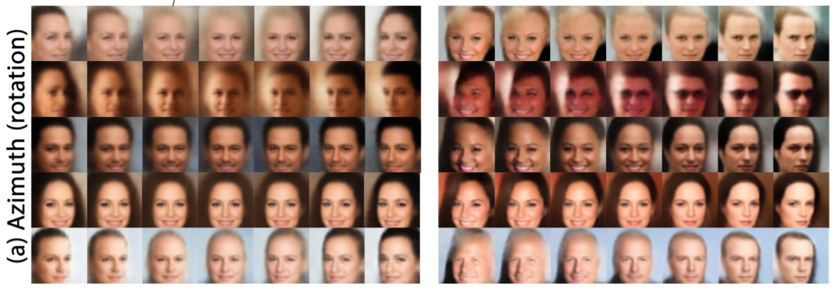
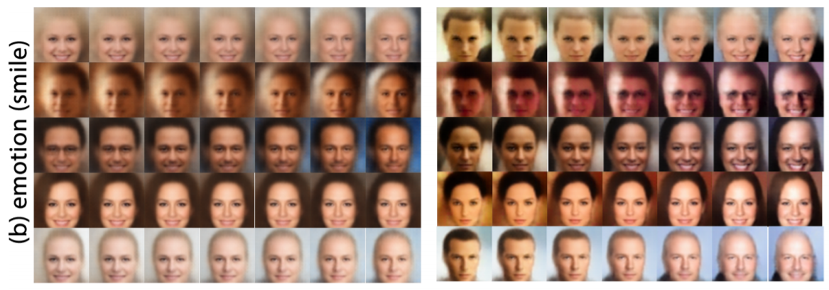
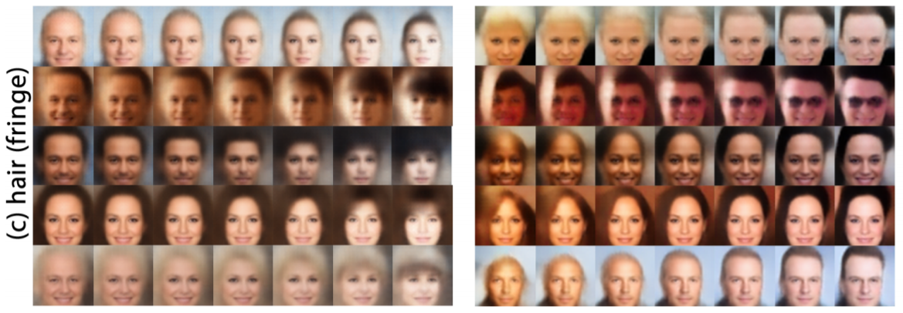
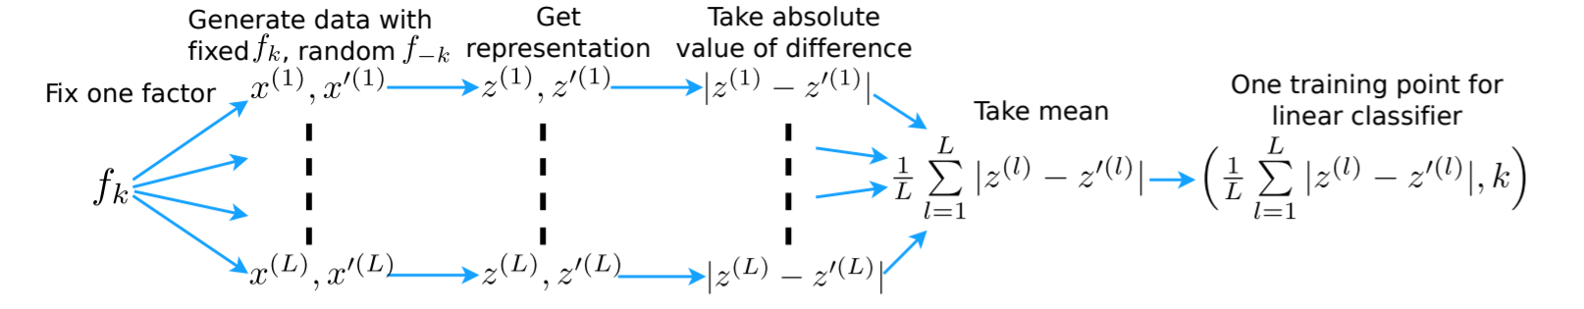
Analysis
Qualitative analysis
Quantitative analysis
Independence : correlation between latent dimensions
Interpretability : robust classification even with simple classifier

Slide 9
Extensions
Other interpretation
[4] Burgess, Christopher P., et al. "Understanding disentangling in $\beta $-VAE." arXiv preprint arXiv:1804.03599 (2018).
[5] Mathieu, Emile, et al. "Disentangling Disentanglement." arXiv preprint arXiv:1812.02833 (2018).
Several other variants
Beta-TCVAE [6]
Factor-VAE [7]
DIP-VAE [8]
[6] Chen, Tian Qi, et al. "Isolating sources of disentanglement in variational autoencoders." Advances in Neural Information Processing Systems. 2018.
[7] Kim, Hyunjik, and Andriy Mnih. "Disentangling by factorising." arXiv preprint arXiv:1802.05983 (2018).
[8] Kumar, Abhishek, Prasanna Sattigeri, and Avinash Balakrishnan. "Variational inference of disentangled latent concepts from unlabeled observations." arXiv preprint arXiv:1711.00848 (2017).

Slide 10
GPP-VAE Intro
Motivation
Prior assumption that latent encodings are i.i.d. across dimensions and samples does not fit to real-world problem
Accounting for covariances between samples can yield a better model
How
Combine VAE with Gaussian Process prior
Leveraging the auxiliary data
Aim
Model the relationship between the latent encodings and the auxiliary data
Disentangle sample correlations induced by different auxiliary data
Predict the latent codes when auxiliary data is unobserved
Generate the data for any configuration of the auxiliary data

Slide 11
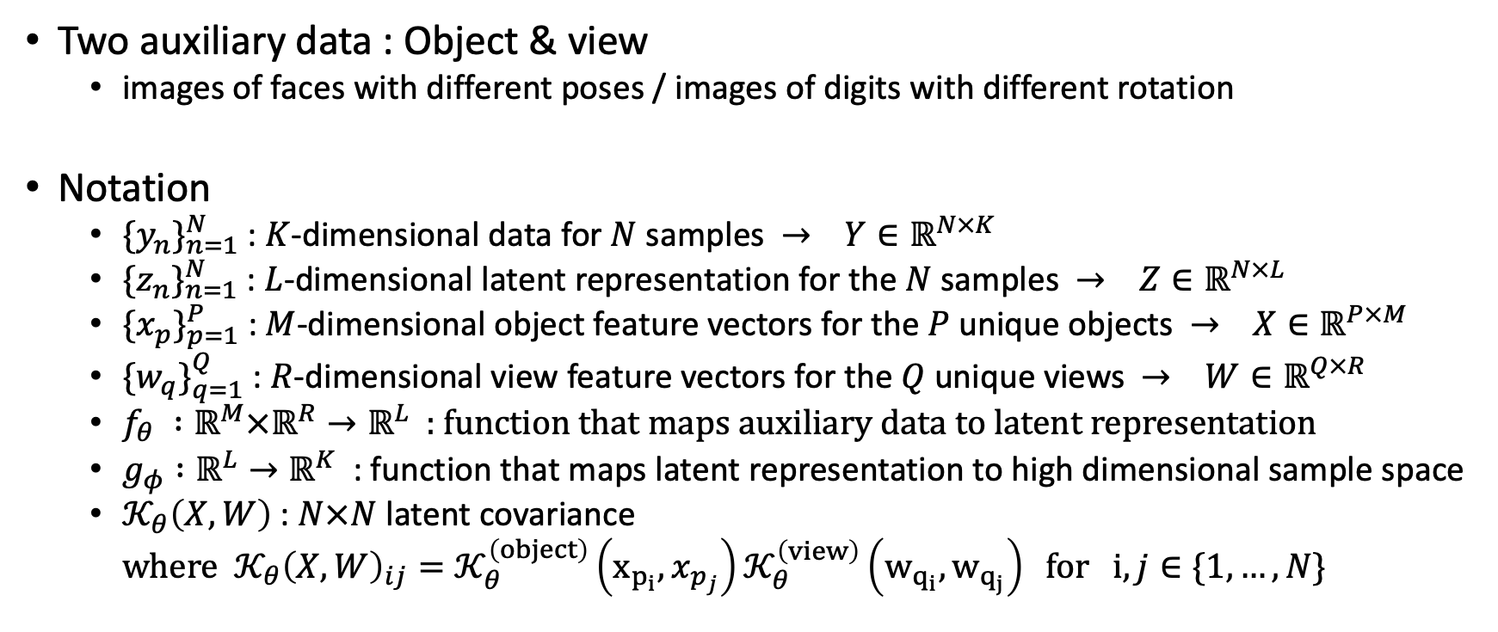
Settings
Two auxiliary data : Object & view
images of faces with different poses / images of digits with different rotation
Notation
${\{y_{n}\}}_{n=1}^{N}$ : $K$-dimensional data for $N$ samples $→ Y∈ℝ^{N×K}$
${\{z_{n}\}}_{n=1}^{N}$ : $L$-dimensional latent representation for the $N$ samples $→ Z∈ℝ^{N×L}$
${\{x_{p}\}}_{p=1}^{P}$ : $M$-dimensional object feature vectors for the $P$ unique objects $→ X∈ℝ^{P×M}$
${\{w_{q}\}}_{q=1}^{Q}$ : $R$-dimensional view feature vectors for the $Q$ unique views $→ W∈ℝ^{Q×R}$
$f_{θ} :ℝ^{M}×ℝ^{R}→ℝ^{L}$ : function that maps auxiliary data to latent representation
$g_{φ} :ℝ^{L}→ℝ^{K}$ : function that maps latent representation to high dimensional sample space
$𝒦_{θ}\left(X, W\right)$ : $N×N$ latent covariance
$where 𝒦_{θ}{\left(X, W\right)}_{ij}=𝒦_{θ}^{\left(object\right)}\left(x_{p_{i}},x_{p_{j}}\right)𝒦_{θ}^{\left(view\right)}\left(w_{q_{i}},w_{q_{j}}\right) for i,j∈\{1,…,N\}$

Slide 12
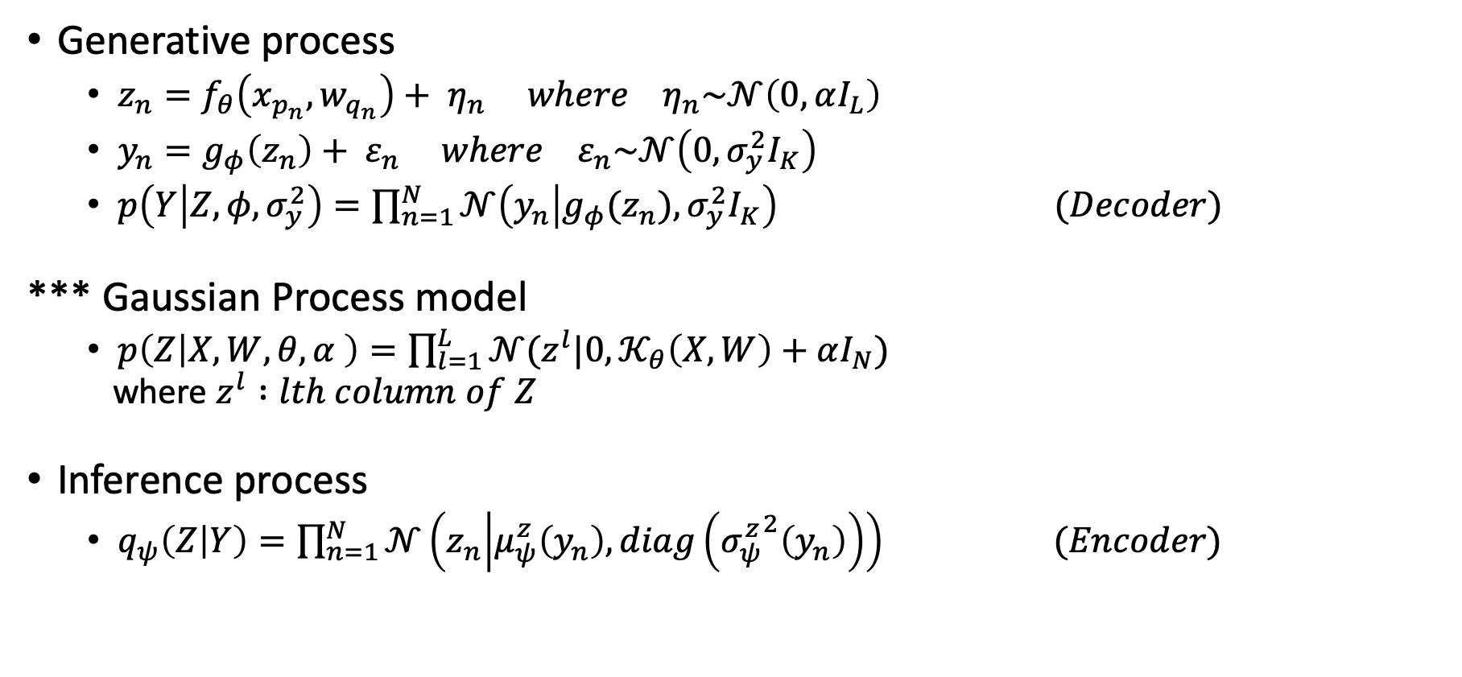
Model construction
Generative process
$z_{n}=f_{θ}\left(x_{p_{n}}, w_{q_{n}}\right)+ η_{n} where η_{n}\sim 𝒩\left(0, αI_{L}\right)$
$y_{n}=g_{φ}\left(z_{n}\right)+ ε_{n} where ε_{n}\sim 𝒩\left(0, σ_{y}^{2}I_{K}\right)$
$p\left(Y | Z,φ,σ_{y}^{2}\right)=\prod_{n=1}^{N}{𝒩\left(y_{n} | g_{φ}(z_{n}),σ_{y}^{2}I_{K}\right)} (Decoder)$
*** Gaussian Process model
$p\left(Z | X, W,θ,α \right)=\prod_{l=1}^{L}{𝒩(z^{l}|0,𝒦_{θ}\left(X, W\right)+αI_{N})}$
where $z^{l} :lth column of Z$
Inference process
$q_{ψ}\left(Z | Y\right)=\prod_{n=1}^{N}{𝒩\left(z_{n} | μ_{ψ}^{z}\left(y_{n}\right), diag\left({σ_{ψ}^{z}}^{2}\left(y_{n}\right)\right)\right)} (Encoder)$

Slide 13
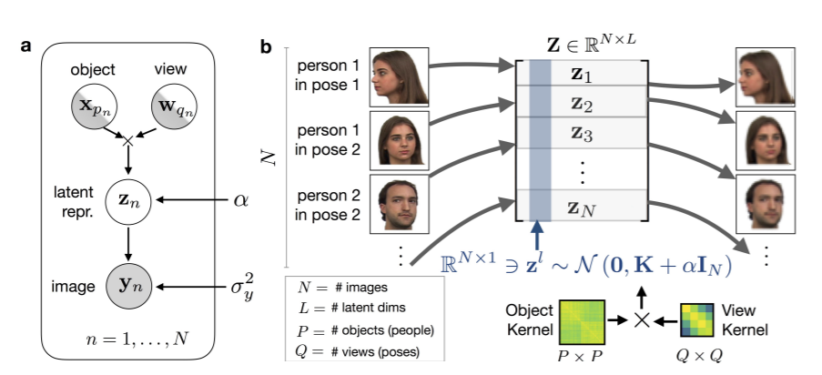

Slide 14
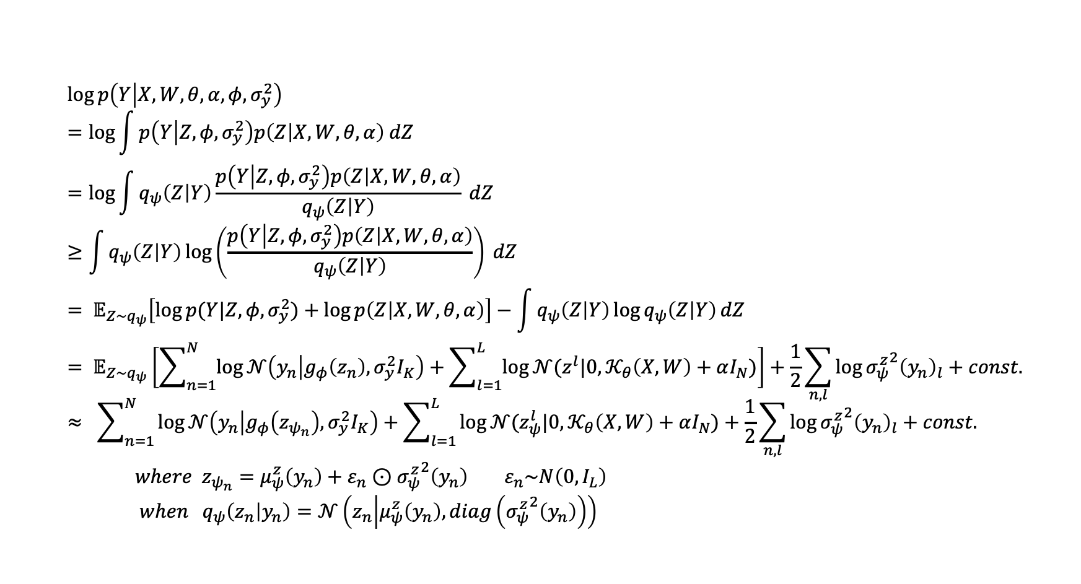
ELBO
$$\log{p\left(Y | X, W,θ,α,φ, σ_{y}^{2}\right)} \\ =\log{\int{p\left(Y | Z,φ,σ_{y}^{2}\right)p\left(Z | X,W,θ,α\right) dZ}} \\ =\log{\int{q_{ψ}\left(Z | Y\right)\frac{p\left(Y | Z,φ,σ_{y}^{2}\right)p\left(Z | X,W,θ,α\right)}{q_{ψ}\left(Z | Y\right)} dZ}} \\ ≥\int{q_{ψ}\left(Z | Y\right)\log\left(\frac{p\left(Y | Z,φ,σ_{y}^{2}\right)p\left(Z | X,W,θ,α\right)}{q_{ψ}\left(Z | Y\right)}\right)} dZ \\ = 𝔼_{Z\sim q_{ψ}}\left[\log{p(Y|Z, φ, σ_{y}^{2})}+\log{p\left(Z | X,W,θ,α\right)}\right]−\int{q_{ψ}\left(Z | Y\right)\log{q_{ψ}\left(Z | Y\right)}dZ} \\ = 𝔼_{Z\sim q_{ψ}}\left[\sum_{n=1}^{N}{\log{𝒩\left(y_{n} | g_{φ}\left(z_{n}\right),σ_{y}^{2}I_{K}\right)}}+\sum_{l=1}^{L}{\log{𝒩(z^{l}|0,𝒦_{θ}\left(X, W\right)+αI_{N})}}\right]+\frac{1}{2}\sum_{n,l}{\log{{σ_{ψ}^{z}}^{2}{\left(y_{n}\right)}_{l}+const.}} \\ ≈ \sum_{n=1}^{N}{\log{𝒩\left(y_{n} | g_{φ}\left(z_{ψ_{n}}\right),σ_{y}^{2}I_{K}\right)}+\sum_{l=1}^{L}{\log{𝒩(z_{ψ}^{l}|0,𝒦_{θ}\left(X, W\right)+αI_{N})}}}+\frac{1}{2}\sum_{n,l}{\log{{σ_{ψ}^{z}}^{2}{\left(y_{n}\right)}_{l}}}+const.$$ $where z_{ψ_{n}}=μ_{ψ}^{z}\left(y_{n}\right)+ε_{n}⊙{σ_{ψ}^{z}}^{2}\left(y_{n}\right) ε_{n}\sim N\left(0, I_{L}\right)$
$when q_{ψ}\left(z_{n} | y_{n}\right)=𝒩\left(z_{n} | μ_{ψ}^{z}\left(y_{n}\right), diag\left({σ_{ψ}^{z}}^{2}\left(y_{n}\right)\right)\right)$

Slide 15
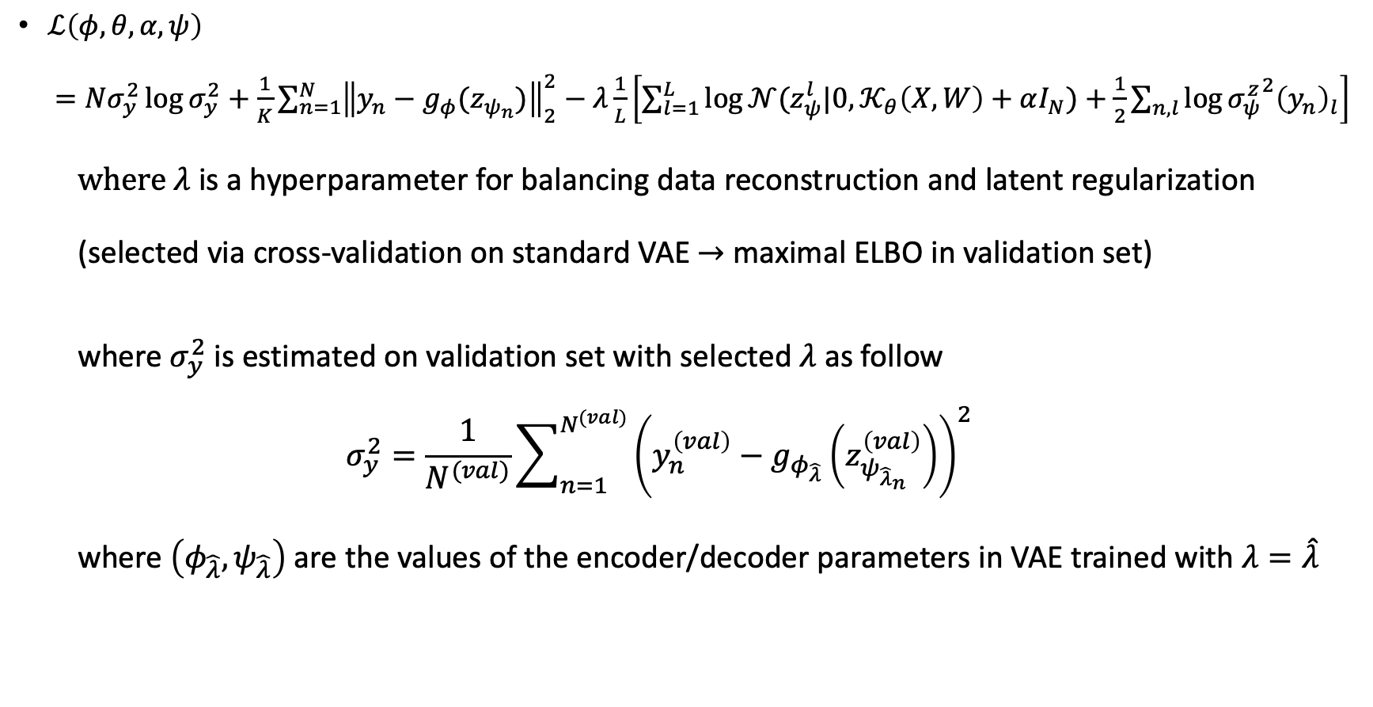
Loss function
$ℒ\left(φ,θ, α,ψ\right)$ $=Nσ_{y}^{2}\log{σ_{y}^{2}}+\frac{1}{K}\sum_{n=1}^{N}{{\left\|y_{n}−g_{φ}(z_{ψ_{n}})\right\|}_{2}^{2}}−λ\frac{1}{L}\left[\sum_{l=1}^{L}{\log{𝒩(z_{ψ}^{l}|0,𝒦_{θ}\left(X, W\right)+αI_{N})}}+\frac{1}{2}\sum_{n,l}{\log{{σ_{ψ}^{z}}^{2}{\left(y_{n}\right)}_{l}}}\right]$
where $λ$ is a hyperparameter for balancing data reconstruction and latent regularization
(selected via cross-validation on standard VAE $→$ maximal ELBO in validation set)
where $σ_{y}^{2}$ is estimated on validation set with selected $λ$ as follow
$$σ_{y}^{2}=\frac{1}{N^{(val)}}\sum_{n=1}^{N^{(val)}}{{\left(y_{n}^{\left(val\right)}−g_{φ_{\hat{λ}}}\left(z_{ψ_{{\hat{λ}}_{n}}}^{\left(val\right)}\right)\right)}^{2}}$$
where $\left(φ_{\hat{λ}},ψ_{\hat{λ}}\right)$ are the values of the encoder/decoder parameters in VAE trained with $λ=\hat{λ}$

Slide 16
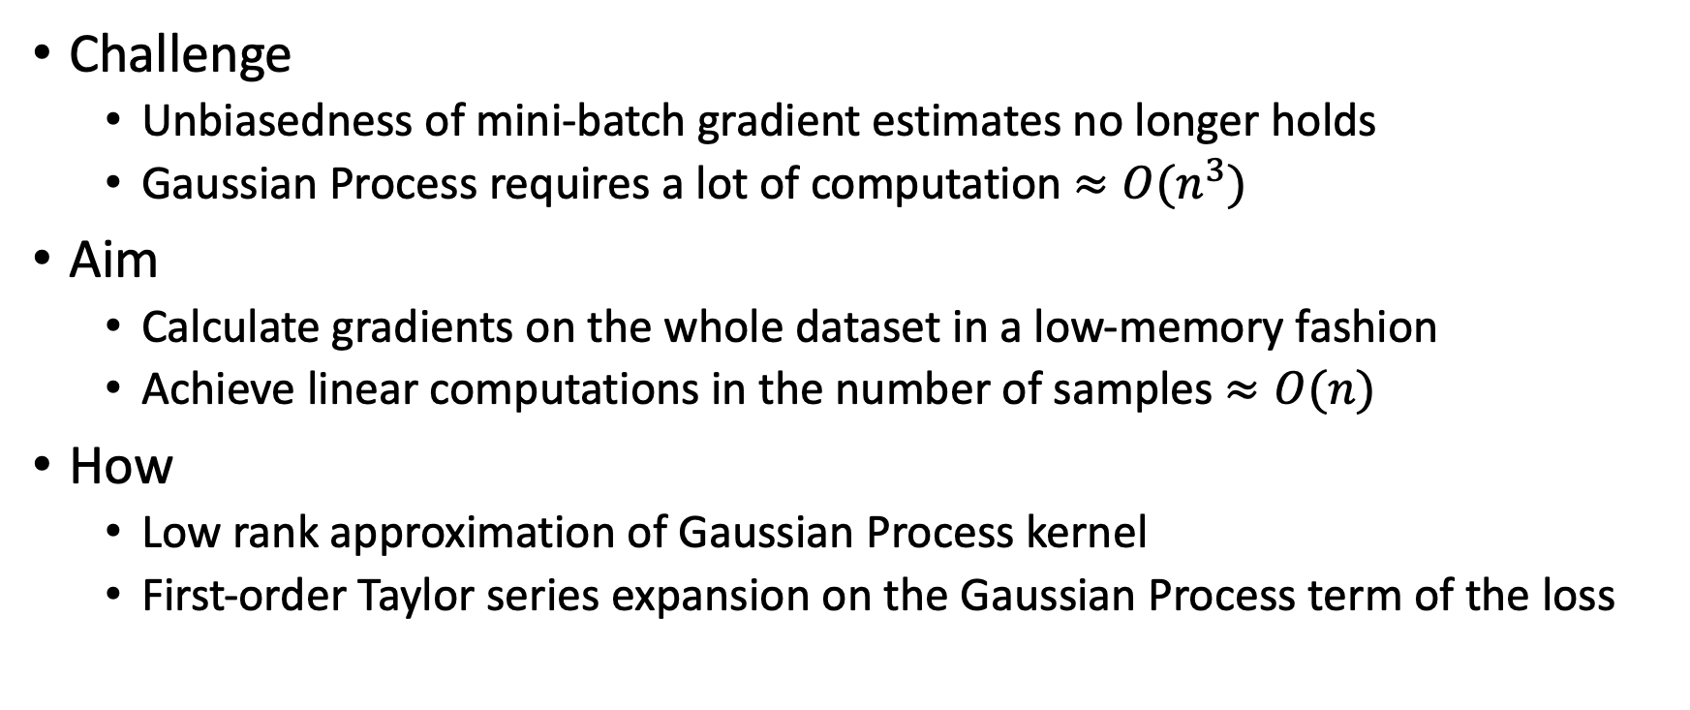
Problems
Challenge
Unbiasedness of mini-batch gradient estimates no longer holds
Gaussian Process requires a lot of computation $≈O(n^{3})$
Aim
Calculate gradients on the whole dataset in a low-memory fashion
Achieve linear computations in the number of samples $≈O(n)$
How
Low rank approximation of Gaussian Process kernel
First-order Taylor series expansion on the Gaussian Process term of the loss

Slide 17
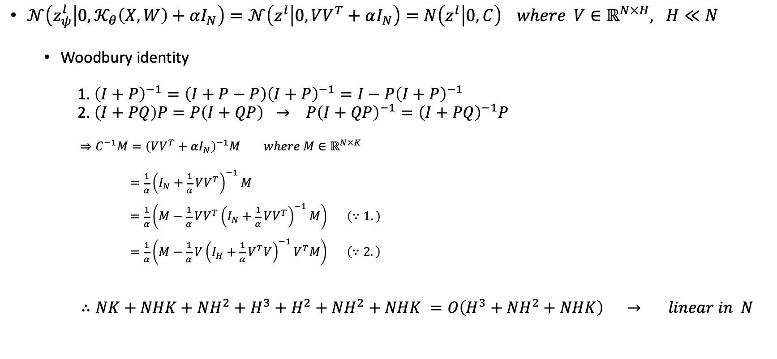
Low rank approximation
$𝒩\left(z_{ψ}^{l} | 0,𝒦_{θ}\left(X, W\right)+αI_{N}\right)=𝒩\left(z^{l} | 0,VV^{T}+αI_{N}\right)=N\left(z^{l} | 0, C\right) where V∈ℝ^{N×H}, H≪N$
Woodbury identity
1. ${\left(I+P\right)}^{−1}=\left(I+P−P\right){\left(I+P\right)}^{−1}=I−P{\left(I+P\right)}^{−1}$
2. $\left(I+PQ\right)P=P\left(I+QP\right) → P{\left(I+QP\right)}^{−1}={\left(I+PQ\right)}^{−1}P$
$⇒C^{−1}M={\left(VV^{T}+αI_{N}\right)}^{−1}M where M∈ℝ^{N×K}$
$=\frac{1}{α}{\left(I_{N}+\frac{1}{α}VV^{T}\right)}^{−1}M$
$=\frac{1}{α}\left(M−\frac{1}{α}VV^{T}{\left(I_{N}+\frac{1}{α}VV^{T}\right)}^{−1}M\right) \left(∵1.\right)$
$=\frac{1}{α}\left(M−\frac{1}{α}V{\left(I_{H}+\frac{1}{α}V^{T}V\right)}^{−1}V^{T}M\right) \left(∵2.\right)$
$∴NK+NHK+NH^{2}+H^{3}+H^{2}+NH^{2}+NHK =O\left(H^{3}+NH^{2}+NHK\right) → linear in N$

Slide 18
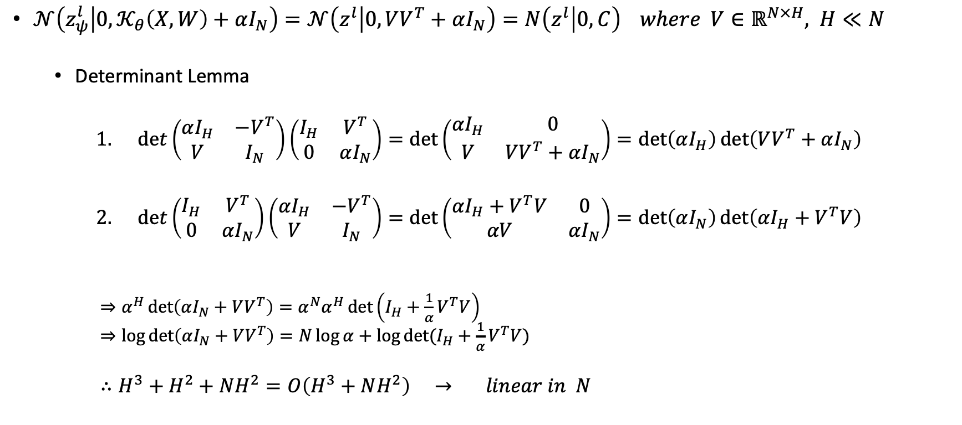
Low rank approximation (cont.)
$𝒩\left(z_{ψ}^{l} | 0,𝒦_{θ}\left(X, W\right)+αI_{N}\right)=𝒩\left(z^{l} | 0,VV^{T}+αI_{N}\right)=N\left(z^{l} | 0, C\right) where V∈ℝ^{N×H}, H≪N$
Determinant Lemma
$det\left(\begin{matrix}αI_{H} & −V^{T} \\ V & I_{N}\end{matrix}\right)\left(\begin{matrix}I_{H} & V^{T} \\ 0 & αI_{N}\end{matrix}\right)=\det\left(\begin{matrix}αI_{H} & 0 \\ V & VV^{T}+αI_{N}\end{matrix}\right)=\det\left(αI_{H}\right)det\left(VV^{T}+αI_{N}\right)$
$det\left(\begin{matrix}I_{H} & V^{T} \\ 0 & αI_{N}\end{matrix}\right)\left(\begin{matrix}αI_{H} & −V^{T} \\ V & I_{N}\end{matrix}\right)=\det\left(\begin{matrix}αI_{H}+V^{T}V & 0 \\ αV & αI_{N}\end{matrix}\right)=\det\left(αI_{N}\right)det\left(αI_{H}+V^{T}V\right)$
$⇒α^{H}\det\left(αI_{N}+VV^{T}\right)=α^{N}α^{H}\det\left(I_{H}+\frac{1}{α}V^{T}V\right)$ $⇒\log{\det\left(αI_{N}+VV^{T}\right)=N\log{α}+\log{\det{(I_{H}+\frac{1}{α}V^{T}V)}}}$
$∴H^{3}+H^{2}+NH^{2}=O\left(H^{3}+NH^{2}\right) → linear in N$

Slide 19
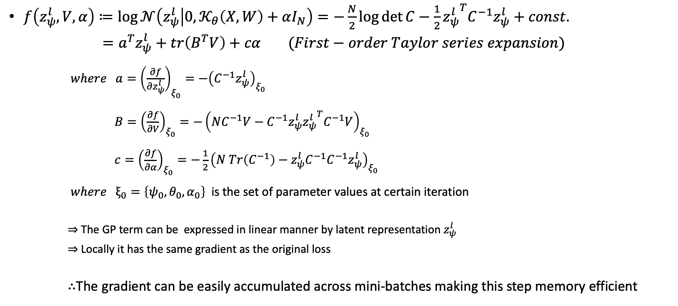
Taylor series expansion
$f\left(z_{ψ}^{l}, V, α\right)≔\log{𝒩\left(z_{ψ}^{l} | 0,𝒦_{θ}\left(X, W\right)+αI_{N}\right)}=−\frac{N}{2}\log{\det{C}}−\frac{1}{2}{z_{ψ}^{l}}^{T}C^{−1}z_{ψ}^{l}+const.$
$=a^{T}z_{ψ}^{l}+tr\left(B^{T}V\right)+cα (First−order Taylor series expansion)$
$where a={\left(\frac{∂f}{∂z_{ψ}^{l}}\right)}_{ξ_{0}}=−{\left(C^{−1}z_{ψ}^{l}\right)}_{ξ_{0}}$
$B={\left(\frac{∂f}{∂V}\right)}_{ξ_{0}}=−{\left(NC^{−1}V−C^{−1}z_{ψ}^{l}{z_{ψ}^{l}}^{T}C^{−1}V\right)}_{ξ_{0}}$
$c={\left(\frac{∂f}{∂α}\right)}_{ξ_{0}}=−\frac{1}{2}{\left(N Tr\left(C^{−1}\right)−z_{ψ}^{l}C^{−1}C^{−1}z_{ψ}^{l}\right)}_{ξ_{0}}$
$where ξ_{0}=\left\{ψ_{0},θ_{0}, α_{0}\right\}$ is the set of parameter values at certain iteration
$⇒$ The GP term can be expressed in linear manner by latent representation $z_{ψ}^{l}$
$⇒$ Locally it has the same gradient as the original loss
$∴$The gradient can be easily accumulated across mini-batches making this step memory efficient

Slide 20
Training process
Step1
Compute latent encodings from the high-dimensional data in a mini-batch unit
Step2
Compute the coefficients of Taylor series expansion with the encodings
Step3
Computes a proxy loss by replacing the GP term by Taylor series expansion
Step4
Accumulated the gradients across data mini-batches
Step5
Update the parameters using the full gradients as in standard gradient descent

Slide 21
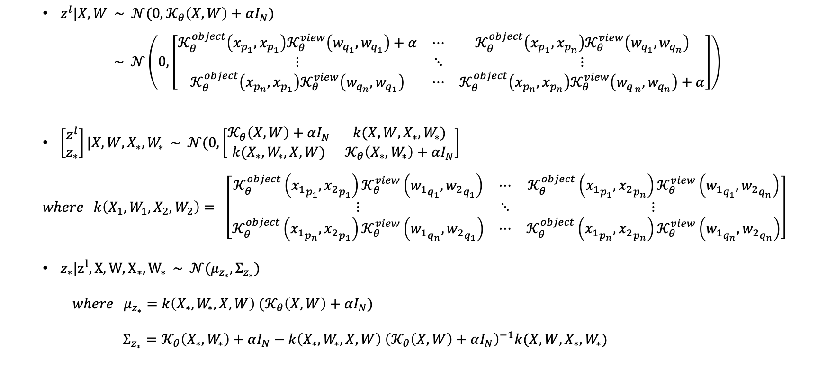
Prediction of latent representation
$z^{l}|X,W \sim 𝒩(0, 𝒦_{θ}\left(X,W\right)+αI_{N})$
$\sim 𝒩\left(0, \left[\begin{matrix}𝒦_{θ}^{object}\left(x_{p_{1}},x_{p_{1}}\right)𝒦_{θ}^{view}\left(w_{q_{1}},w_{q_{1}}\right)+α & ⋯ & 𝒦_{θ}^{object}\left(x_{p_{1}},x_{p_{n}}\right)𝒦_{θ}^{view}\left(w_{q_{1}},w_{q_{n}}\right) \\ ⋮ & ⋱ & ⋮ \\ 𝒦_{θ}^{object}\left(x_{p_{n}},x_{p_{1}}\right)𝒦_{θ}^{view}\left(w_{q_{n}},w_{q_{1}}\right) & ⋯ & 𝒦_{θ}^{object}\left(x_{p_{n}},x_{p_{n}}\right)𝒦_{θ}^{view}\left(w_{q_{ n}},w_{q_{n}}\right)+α\end{matrix}\right]\right)$
$\left[\begin{matrix}z^{l} \\ z_{∗}\end{matrix}\right]|X,W,X_{∗},W_{∗} \sim 𝒩(0, \left[\begin{matrix}𝒦_{θ}\left(X,W\right)+αI_{N} & k(X,W,X_{∗},W_{∗}) \\ k(X_{∗}, W_{∗}, X,W) & 𝒦_{θ}\left(X_{∗},W_{∗}\right)+αI_{N}\end{matrix}\right]$
$$where k\left(X_{1},W_{1},X_{2},W_{2}\right)= \left[\begin{matrix}𝒦_{θ}^{object}\left({x_{1}}_{p_{1}},{x_{2}}_{p_{1}}\right)𝒦_{θ}^{view}\left({w_{1}}_{q_{1}},{w_{2}}_{q_{1}}\right) & ⋯ & 𝒦_{θ}^{object}\left({x_{1}}_{p_{1}},{x_{2}}_{p_{n}}\right)𝒦_{θ}^{view}\left({w_{1}}_{q_{1}},{w_{2}}_{q_{n}}\right) \\ ⋮ & ⋱ & ⋮ \\ 𝒦_{θ}^{object}\left({x_{1}}_{p_{n}},{x_{2}}_{p_{1}}\right)𝒦_{θ}^{view}\left({w_{1}}_{q_{n}},{w_{2}}_{q_{1}}\right) & ⋯ & 𝒦_{θ}^{object}\left({x_{1}}_{p_{n}},{x_{2}}_{p_{n}}\right)𝒦_{θ}^{view}\left({w_{1}}_{q_{n}},{w_{2}}_{q_{n}}\right)\end{matrix}\right]$$
$z_{∗}|z^{l},X,W,X_{∗}, W_{∗} \sim 𝒩(μ_{z_{∗}}, Σ_{z_{∗}})$
$where μ_{z_{∗}}=k\left(X_{∗}, W_{∗}, X,W\right) (𝒦_{θ}\left(X,W\right)+αI_{N})$
$Σ_{z_{∗}}=𝒦_{θ}\left(X_{∗},W_{∗}\right)+αI_{N}−k\left(X_{∗}, W_{∗}, X,W\right) {\left(𝒦_{θ}\left(X,W\right)+αI_{N}\right)}^{−1}k(X,W,X_{∗},W_{∗})$

Slide 22
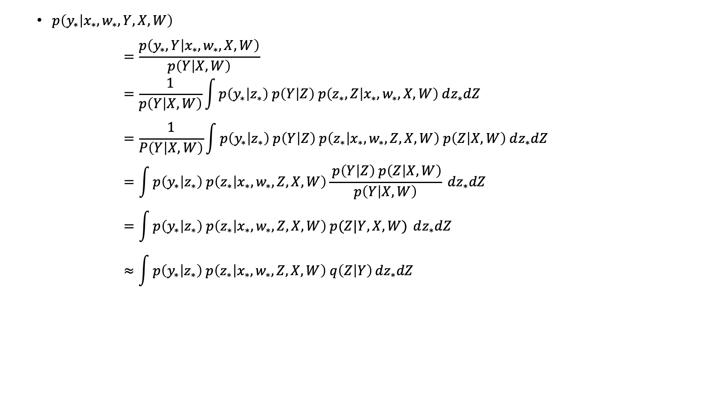
Prediction on generated data
$p\left(y_{∗} | x_{∗}, w_{∗}, Y, X,W\right)$
$$=\frac{p\left(y_{∗}, Y | x_{∗}, w_{∗}, X, W\right)}{p\left(Y | X, W\right)} \\ =\frac{1}{p\left(Y | X, W\right)}\int{p\left(y_{∗} | z_{∗}\right) p\left(Y | Z\right) p\left(z_{∗}, Z | x_{∗}, w_{∗}, X, W\right) dz_{∗}dZ} \\ =\frac{1}{P\left(Y | X, W\right)}\int{p\left(y_{∗} | z_{∗}\right) p\left(Y | Z\right) p\left(z_{∗} | x_{∗}, w_{∗}, Z, X, W\right) p\left(Z | X, W\right) dz_{∗}dZ } \\ =\int{p\left(y_{∗} | z_{∗}\right) p\left(z_{∗} | x_{∗}, w_{∗}, Z, X, W\right)\frac{ p\left(Y | Z\right) p\left(Z | X, W\right)}{p\left(Y | X, W\right)}} dz_{∗}dZ \\ =\int{p\left(y_{∗} | z_{∗}\right) p\left(z_{∗} | x_{∗}, w_{∗}, Z, X, W\right) p(Z|Y, X, W)} dz_{∗}dZ \\ ≈\int{p\left(y_{∗} | z_{∗}\right) p\left(z_{∗} | x_{∗},w_{∗}, Z, X, W\right) q\left(Z | Y\right)}dz_{∗}dZ$$

Slide 23
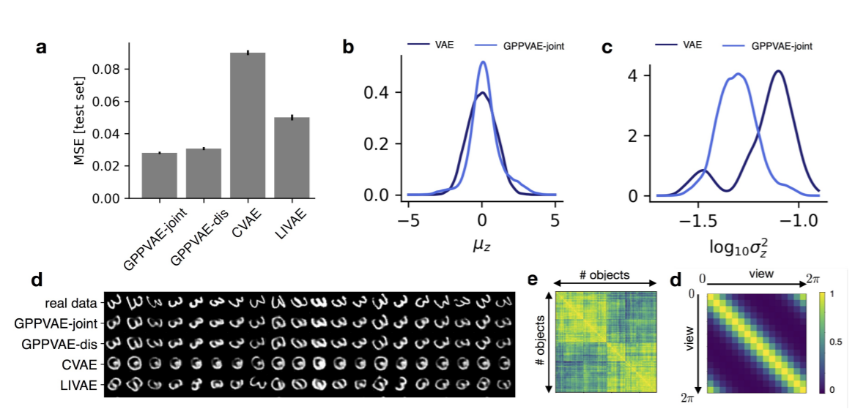

Slide 24
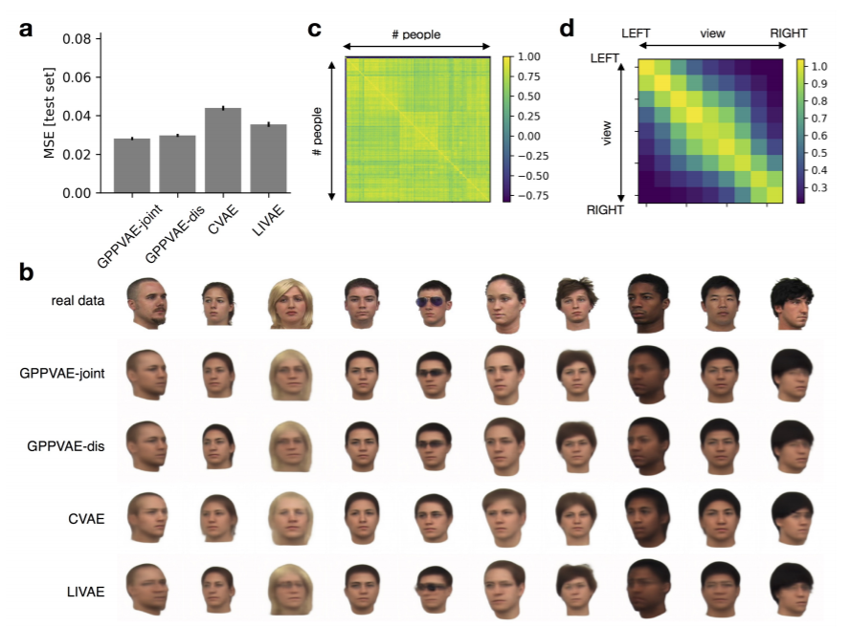

Slide 25
Conclusion
VAE
Introduced improved and general approach for variational inference
Strong assumptions are used
Beta VAE
Encourage disentanglement by simply adding one hyperparameter
Need more explanation
Information theoretic approach can be further considered
GPP-VAE
Correlation among latent samples are considered with GP prior
Posterior Predictive distribution can be utilized
Efficiently learnable with several relaxations
Further improvement seems difficult

Slide 26
Thank you for your attention

